Slide 1

ECON7860
Big Data Analytics for Business
Group Project
HR_Analytics
Ou Jiajie 20436335
Miao Zhaokuan 20431406
Lu Qichang 20436343
Yang Yaxin 20442041
Pan Yihan 20428715

Slide 2
04. Conclusion
CONTENTS
03. Results & Interpretation
02. Data Analysis
01. Introduction

Slide 3

1.1 Background
PART1
1.2 Observation
Introduction
1.3 Variables
1.4 objective

Slide 4

1.1Background
Big data is a high-capacity, high-speed, and high-variety information asset that requires cost-effective and innovative forms of information processing to enhance insight and decision-making capabilities.
Generally, when dealing with big data, CRISP-DM It is a concept that cannot be ignored. It is a complete set of data mining methods, applicable to standard methodology of all industries, and is widely used. It is divided into six stages, including business understanding, data understanding, data preparation, model building, Model evaluation and model release.

Slide 5

1.2 Observation
Satisfaction _level: Level of employee satisfaction
Last_ evaluation: Rating from last rating
Number_ project: Number of projects worked
Average_ month_ hours: Monthly average hours worked
Time_ spend_ company: Years of work in the company
Work_ accident: 0 - Did not have an accident at work
and 1 - Had an accident at work
Left: Dismissal indicator, 0 - Contracted and 1 - Off
Promotion_last_5years: Promotion indicative, 0 - No and 1 - Yes
Sales: Department
Salary: Salary, Low, Medium and High
And missing value is none!

Slide 6
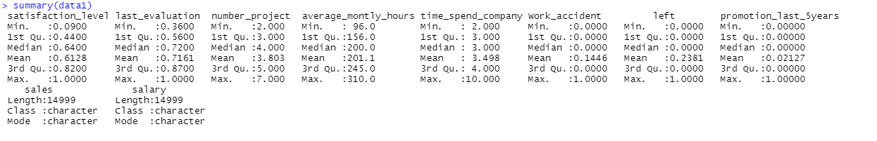
1.3 Variables
Before data cleaning, the min, median, mean, and max of the data set can be obtained by observing the data through the summary function.
You may add something here.Here’s the place for you to add something.
You may add something here.Here’s the place for you to add something.
You may add something here.Here’s the place for you to add something.
You may add something here.Here’s the place for you to add something.

Slide 7
1.4 objective
Identify important features for predicting employee attrition
Build machine leaning models to predict employee attrition
Explore the effect of late factors in predicting employee attrition

Slide 8
2.1 Data Preparation
PART2
Data Analysis
2.2 Methodology Brief
2.3 Modeling

Slide 9
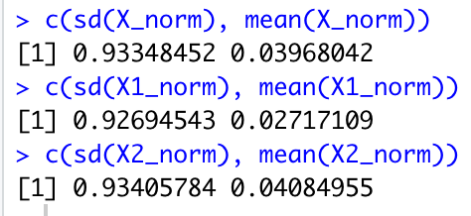


2.1 Data Preparation
Data Cleansing
No need. No unrelated attribute.
Standardization
Z-score normalization with the default scale function in R.
Conform to mean = 0 and standard deviation = 1.
Feature engineering
Transform “sales”(10 levels) and “salary”(3 levels) to dummy variables.
Partition the dataset according to “time_spend_company” (>5 vs. ≤5)

Slide 10
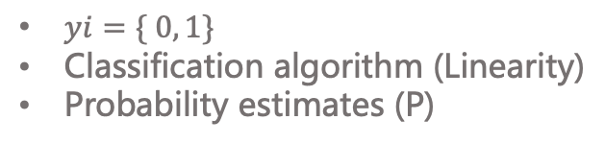
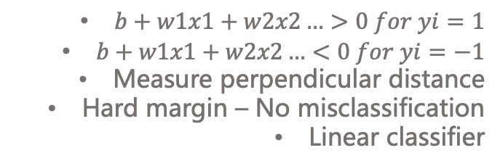
2.2 Methodology Brief
SVM
Logistic Regression
$b+w1x1+w2x2…>0 for yi=1$
$b+w1x1+w2x2…<0 for yi=−1$
Measure perpendicular distance
Hard margin – No misclassification
Linear classifier
$yi=\{ 0, 1\}$
Classification algorithm (Linearity)
Probability estimates (P)
Models
Random forest
K-NN
1) Random sampling to train the decision trees 2) Randomly select the node split attribute 3) Repeat until cannot split 4) Random forest formed by many decision trees
Derive new instance’ target value
k: odd numbers (avoid breakeven)
Classification
Probability Estimation

Slide 11
2.2 Methodology Brief
5-fold nested cross validation
Once for testing, (k-1) times for training.
Mean & Standard deviation.
Validation
method
AUC of precision-recall (PR) curve
Supplementary measure
AUC = 1 perfect discrimination
AUC = 0.5 randomness
Evaluation
metric
F1-measure
Focus on “+” class for unbalanced responses “left”.

Slide 12
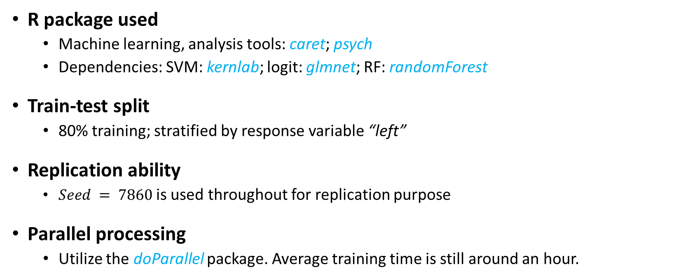
2.3 Modeling – Training (1/2)
R package used
Machine learning, analysis tools: caret; psych
Dependencies: SVM: kernlab; logit: glmnet; RF: randomForest
Train-test split
80% training; stratified by response variable “left”
Replication ability
$Seed = 7860$is used throughout for replication purpose
Parallel processing
Utilize the doParallel package. Average training time is still around an hour.

Slide 13

2.3 Modeling – Training (2/2)
Model Specifications
Train control
Tune length: $tune=15$
Model list: $m∈models$;
Train function
For k-NN, additional

Slide 14
PART3
Results &
Interpretation
3.1 Result Presentation
3.2 Result Interpretation

Slide 15
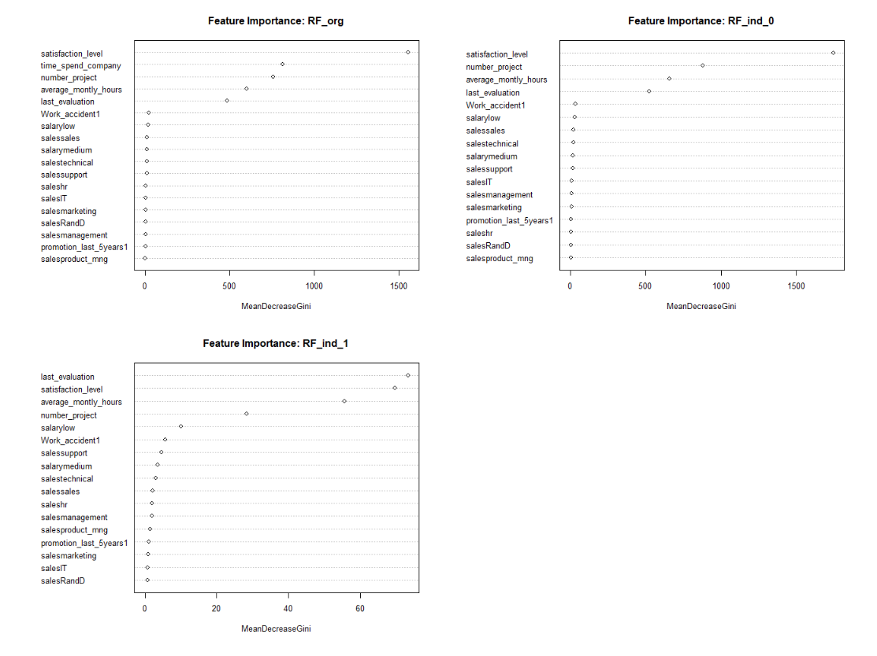
Feature importance

Slide 16
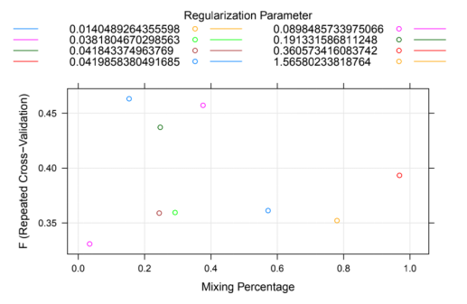
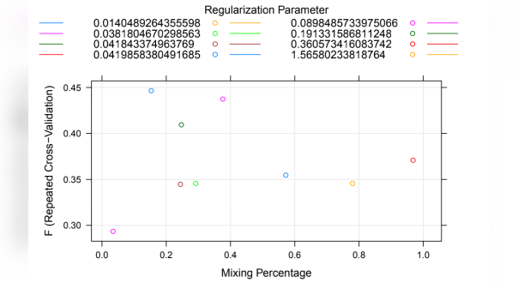

Slide 17
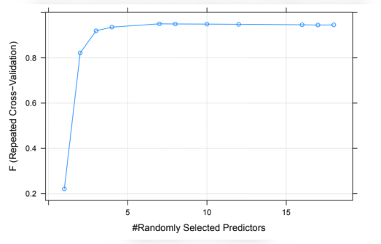
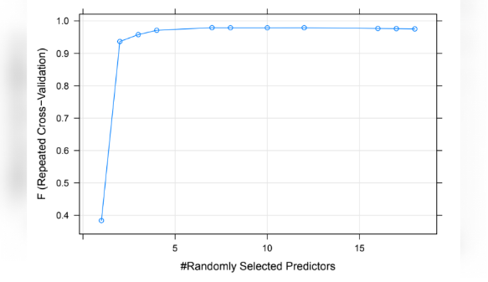

Slide 18
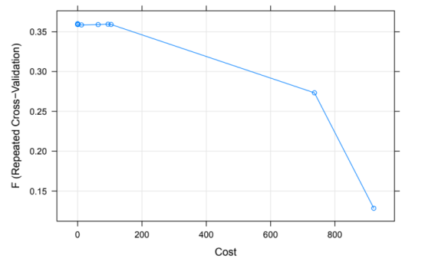
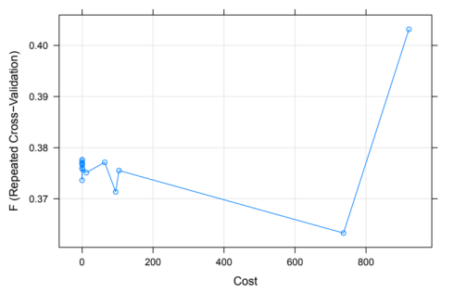

Slide 19
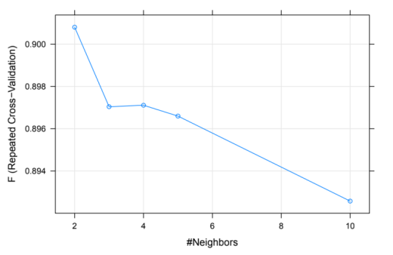
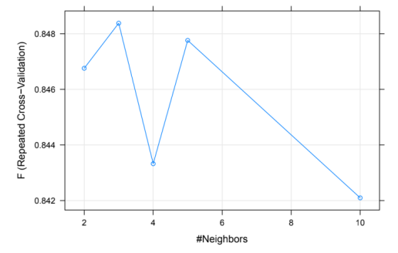

Slide 20
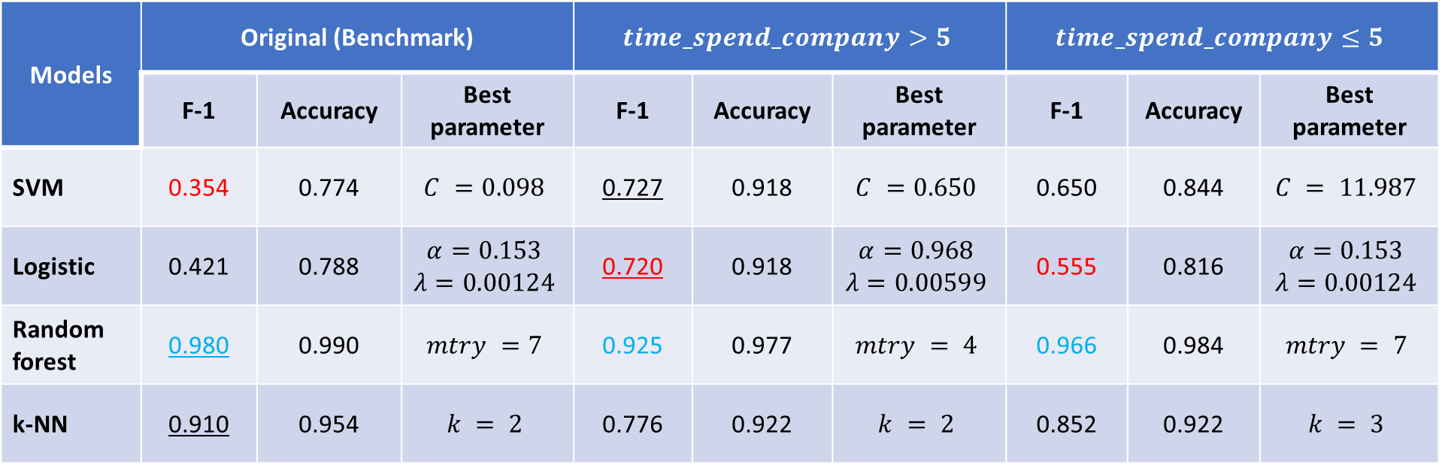
Results Summary
Models | Original (Benchmark) |  |  | $$time_spend_company>5$$ |  |  | $$time_spend_company≤5$$
 | F-1 | Accuracy | Best parameter | F-1 | Accuracy | Best parameter | F-1 | Accuracy | Best parameter
SVM | 0.354 | 0.774 | $$C =0.098$$ | 0.727 | 0.918 | $$C =0.650$$ | 0.650 | 0.844 | $$C = 11.987$$
Logistic | 0.421 | 0.788 | $$α=0.153$$ $$λ=0.00124$$ | 0.720 | 0.918 | $$α=0.968$$ $$λ=0.00599$$ | 0.555 | 0.816 | $$α=0.153$$ $$λ=0.00124$$
Random forest | 0.980 | 0.990 | $$mtry =7$$ | 0.925 | 0.977 | $$mtry = 4$$ | 0.966 | 0.984 | $$mtry = 7$$
k-NN | 0.910 | 0.954 | $$k = 2$$ | 0.776 | 0.922 | $$k = 2$$ | 0.852 | 0.922 | $$k = 3$$

Slide 21
PART4
Conclusion

Slide 22


4.conclusion
Best model
the random Forster is the best model for these data. Because the F test is the best.
Important factor
Satisfaction is the most important factor for employee, so company should try to improve this factor such as raise salary for purpose of mangement company.
It should be noted that the impact of evaluation is also great, which proves that the company has not made changlast es on some key management issues. Therefore, in the next step, the company needs to pay attention to the employees’ thoughts and take actual actions

Slide 23
THANK YOU

